Slide 1
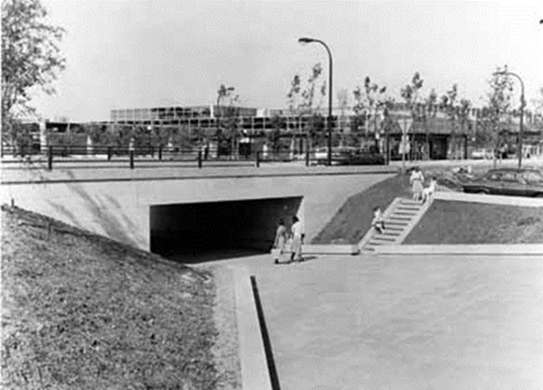
On The Verge
Underpasses – Connecting People, Connecting Place
Celebrating 50 Years of Milton Keynes
Overview to Research Document created by Caroline Hamilton April 2016

Slide 2
UNDERPASSES RESEARCH PROJECT:
As researcher for the Underpasses project I have created a 110 page document containing facts, quotes, articles, images and photographs. The project is to include the creation of an exhibition, two children’s publications, a heritage trail and four interpretation panels. This document has been created to contain information that should be helpful and inform these four outcomes. For the children’s publication for example a general timeline of events and life has been included as well as images and references to life in Britain and children’s memories of MK. In terms of the four estates I have focused on the types of houses built and origin of the street themes.
I have included a large range of images sourced from the MKCDC. These images are accompanied by a reference number (all images in this powerpoint are in the final document with reference numbers and copyright information). The MKCDC is able to grant copyright for these and can provide a high resolution copy of any image required (there will possibly be an admin cost for this). I have also included other images and information that is for research purposes only as I believe this may be helpful for the writers and artists.

Slide 3
MILTON KEYNES
By 2031 Milton Keynes is set to be the UK’s tenth largest urban area with a population of 350,000. This huge thriving city was designated in 1967 to cover nearly 22,000 acres of urban and rural country, including 3 town and thirteen villages, and rise to accommodate a population of 250,000.
The New City was designed foreseeing the rise of car ownership and the evolution of technology. It included cutting edge features of urban design and continues to divide critics. Most all it provided new homes and opportunities to 1000s of families living below the poverty line.

Slide 4
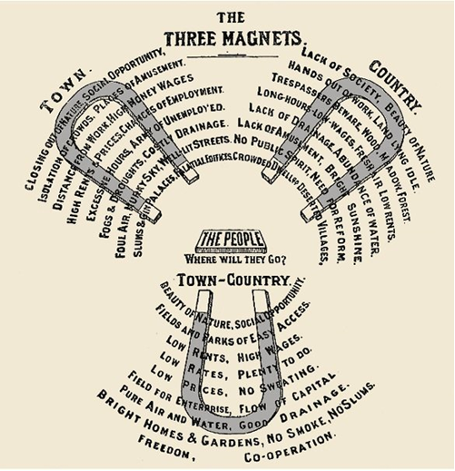
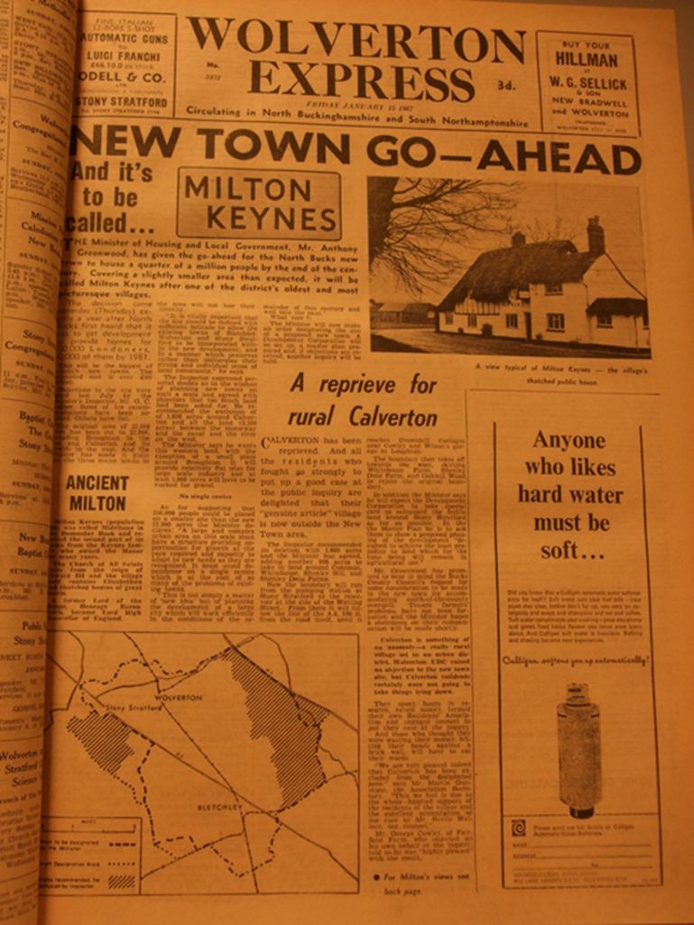
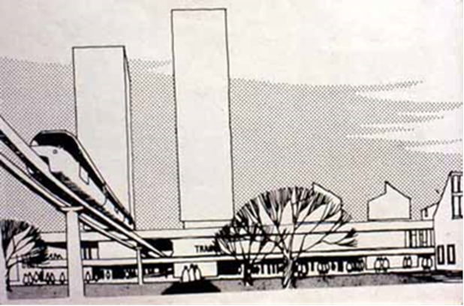
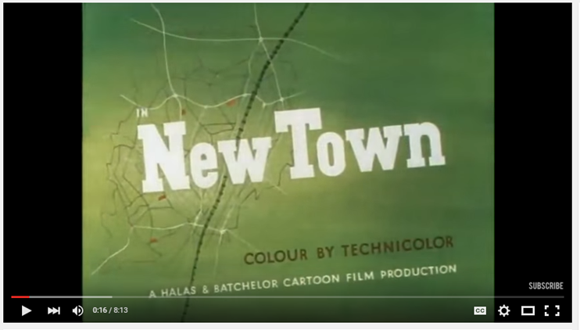
MILTON KEYNES 50 YEARS
In this first section topics covered include:
The origins of the Garden City Movement
The New Towns Act
A list of New Towns
The origins of the New North Bucks town including Pooleyville
The 1966 announcement of the proposed area for the new city
1967 announcement of a new city to be called Milton Keynes

Slide 5
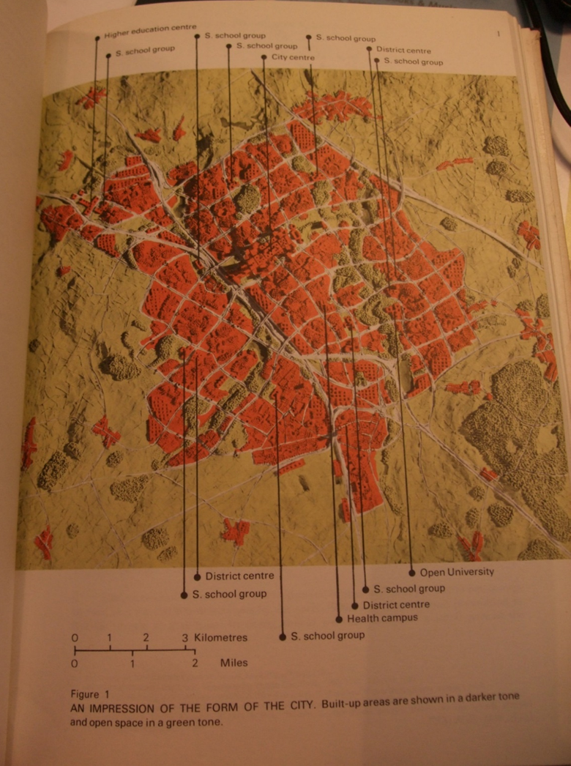
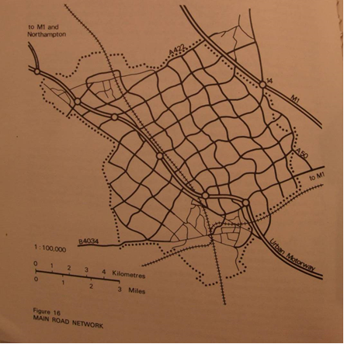
MILTON KEYNES 50 YEARS
In the second half of the first section topics covered include:
The MKDC
The Master Plan – including extensive quotes and images
MK Timeline
General Timeline of events and technology – created with the children's publication in mind
The building of MK
Newspaper articles from 1972 & 1973

Slide 6
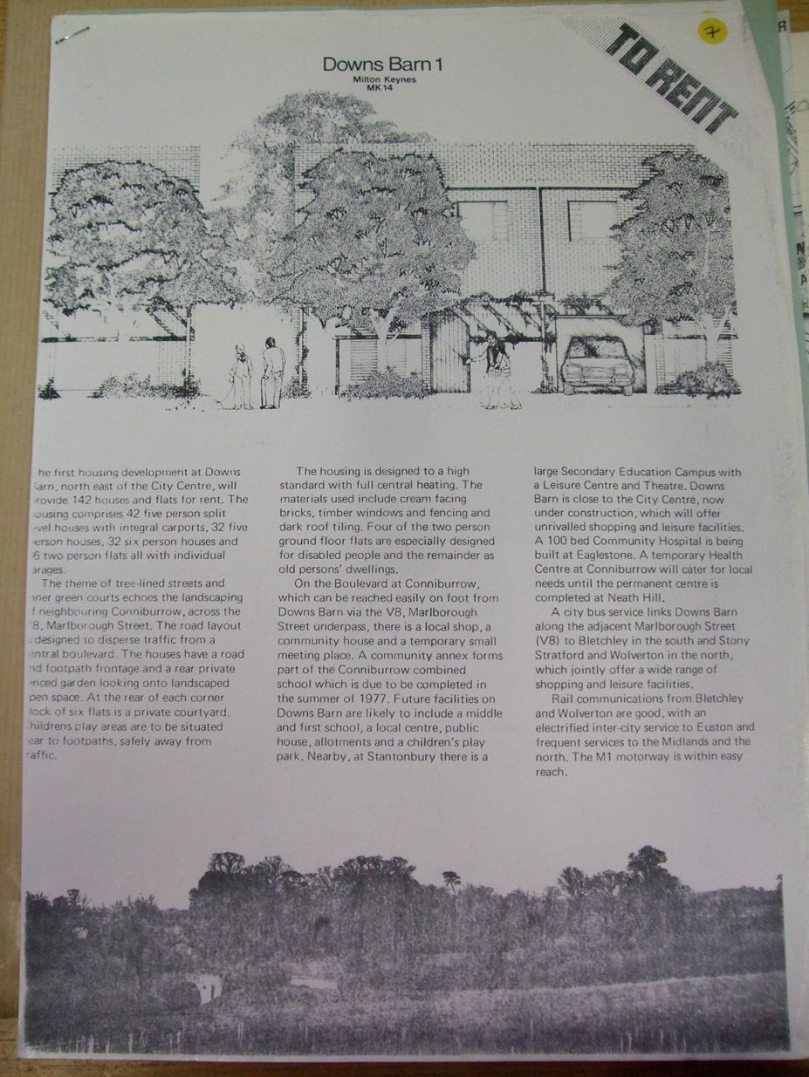
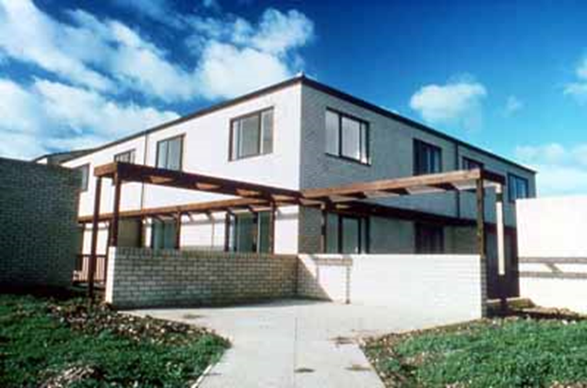
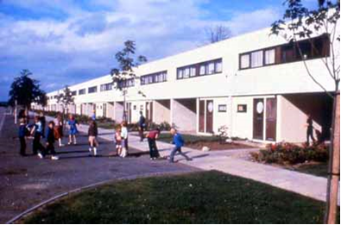
THE FOUR ESTATES: Downs Barn
In this section topics include:
The origin of Downs Barn
Building and the houses of Downs Barn
Early Pictures of Downs Barn

Slide 7
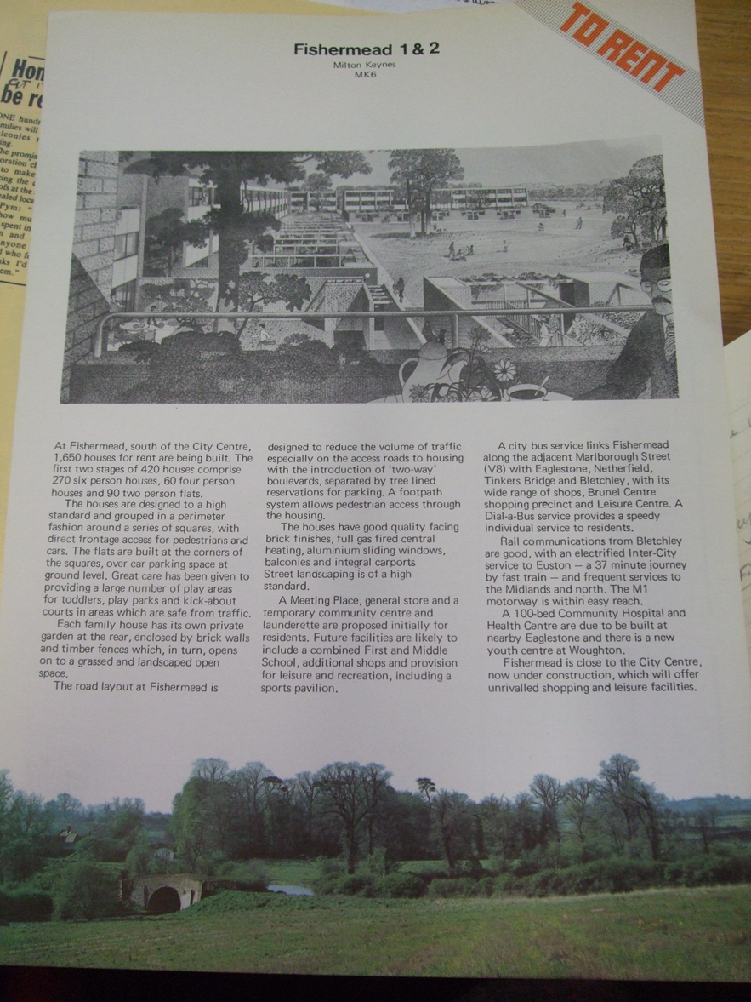
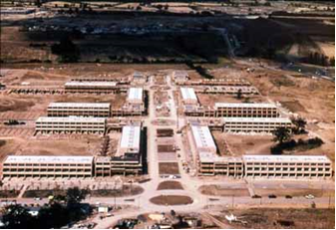
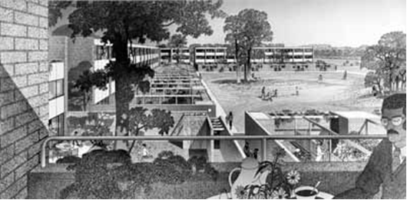
THE FOUR ESTATES: Fishermead
In this section topics include:
The origin of Fishermead
Building and the houses of Fishermead
Early Pictures of Fishermead

Slide 8
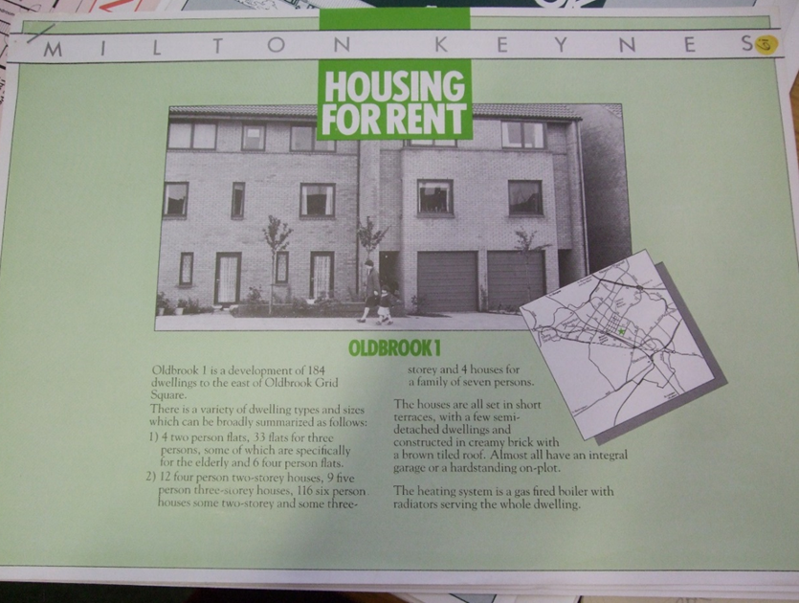
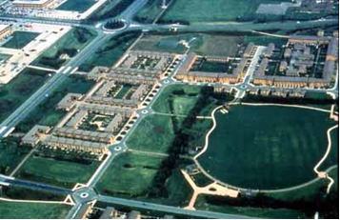
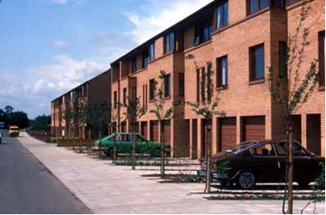
THE FOUR ESTATES: Oldbrook
In this section topics include:
The origin of Oldbrook
Building and the houses of Oldbrook
Early Pictures of Oldbrook

Slide 9
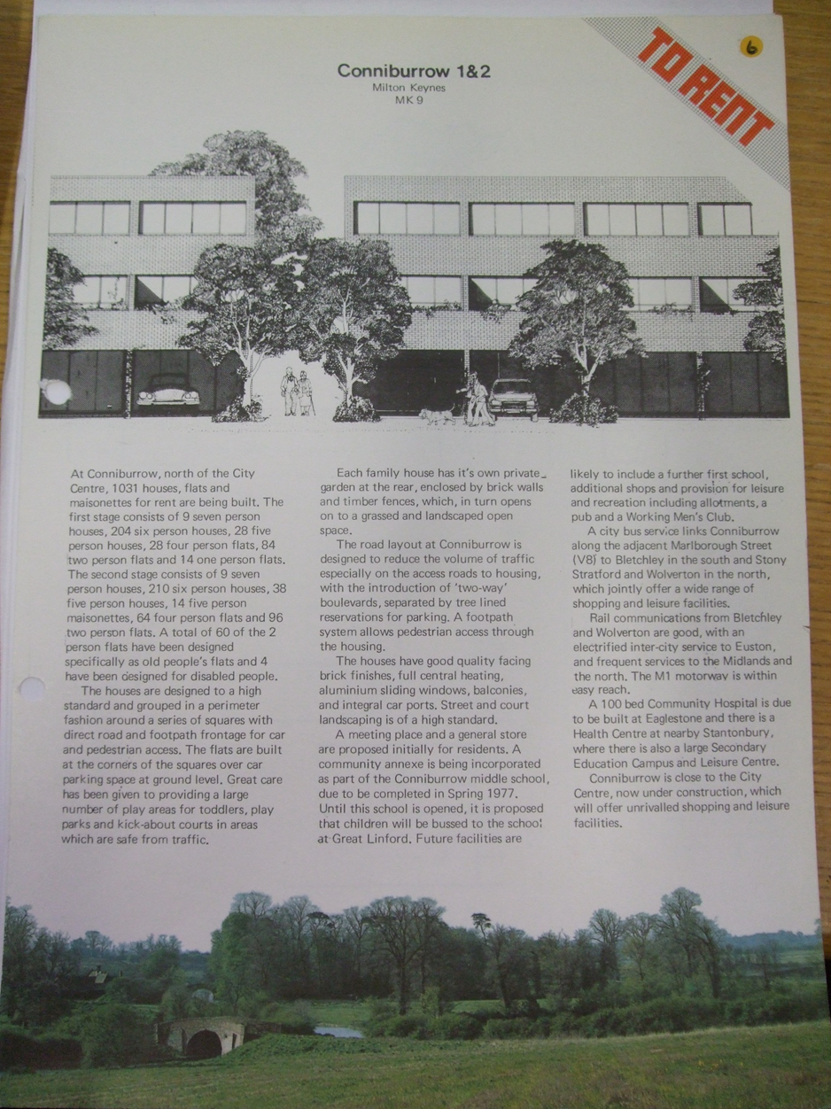
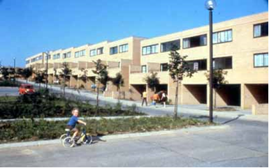
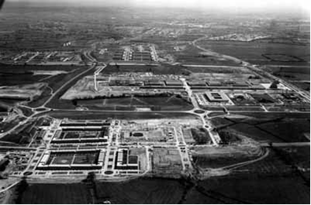
THE FOUR ESTATES: Conniburrow
In this section topics include:
The origin of Conniburrow
Building and the houses of Conniburrow
Early Pictures of Conniburrow

Slide 10
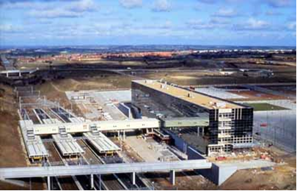
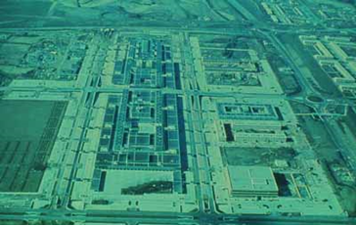
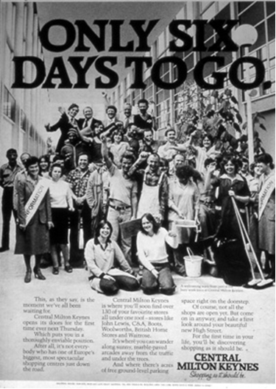
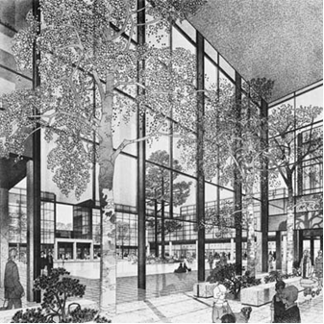
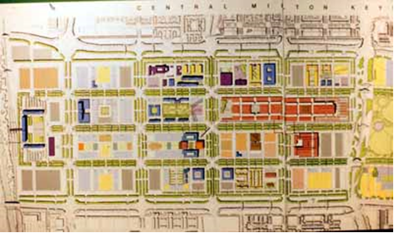
CENTRAL MILTON KEYNES
In this section topics include:
Building CMK
The Shopping Centre
Early pictures of CMK

Slide 11
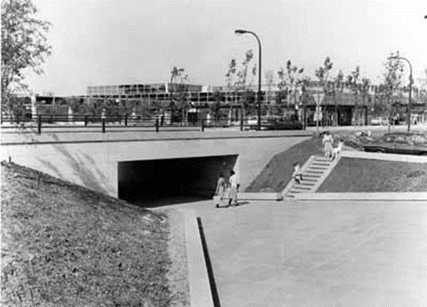
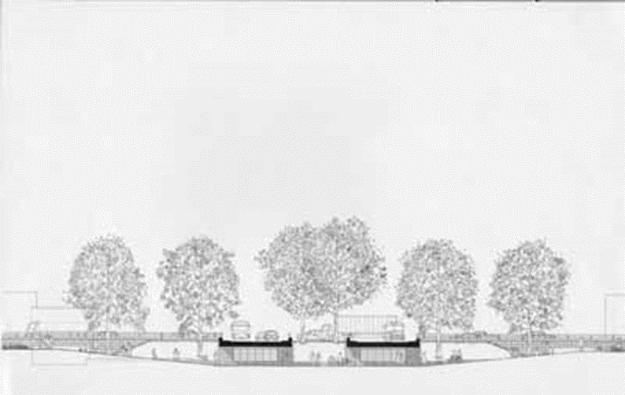
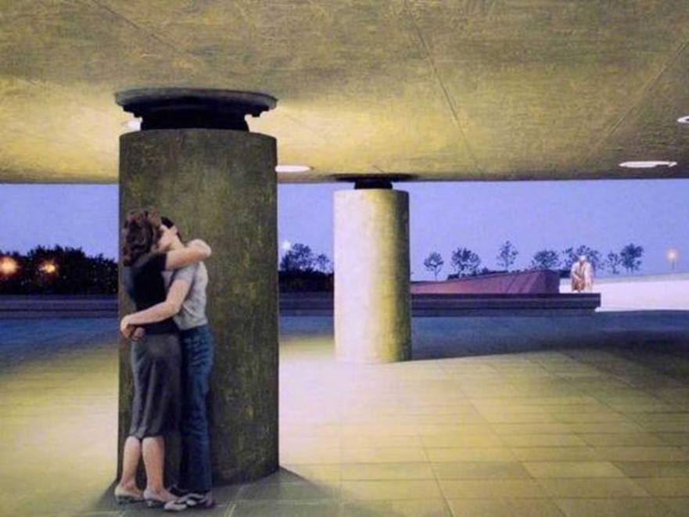
THE UNDERPASSES AND REDWAYS
In this section topics include:
The underpasses
Quotes from Rob Riekie
Art inspired by the underpasses
Early Pictures of the underpasses
The Redways

Slide 12
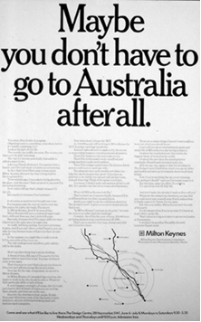
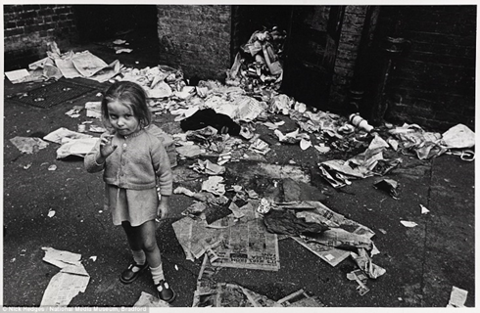
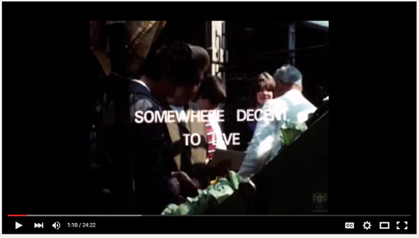
MEMORIES AND THE PEOPLE OF MILTON KEYNES:
In this section topics include:
The slums and poverty in the UK in the 1960s and 1970s
Migration and Assisted migration to Australia

Slide 13
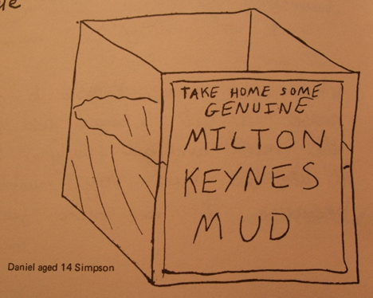
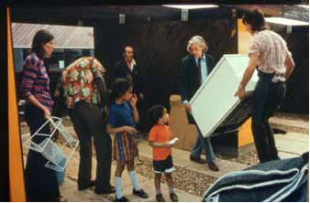
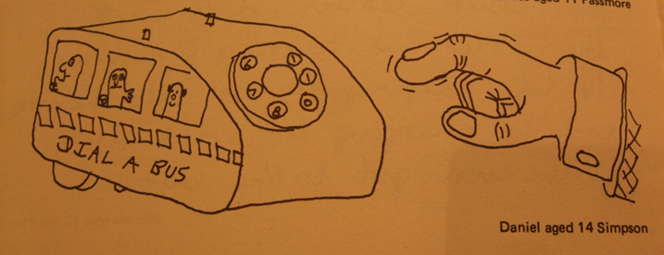
MEMORIES AND THE PEOPLE OF MILTON KEYNES:
In this section topics include:
Moving to MK
The memories of children moving to MK taken from a 1977 publication
Images of people moving in

Slide 14
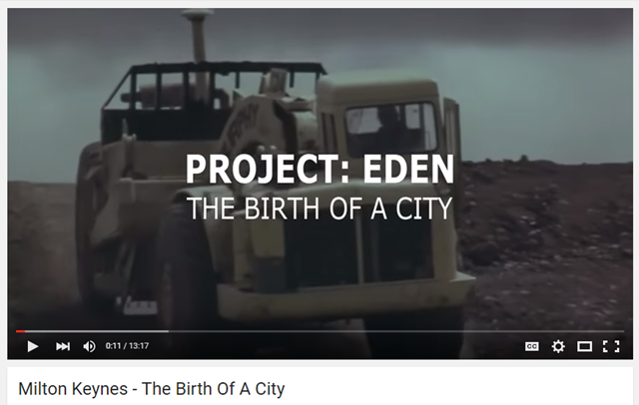
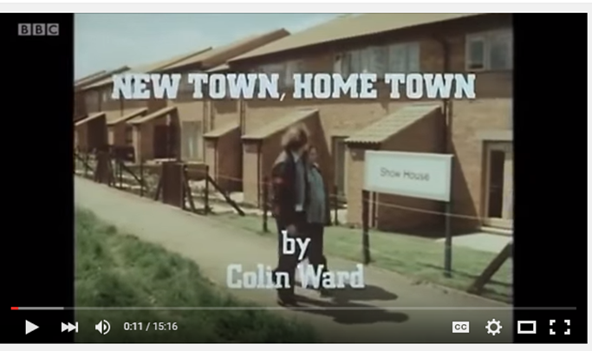
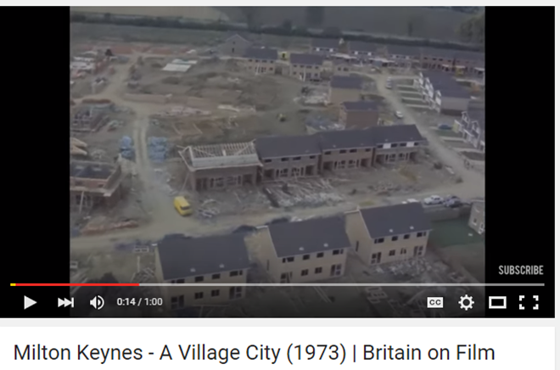
MEMORIES AND THE PEOPLE OF MILTON KEYNES:
In this section topics include:
The links and details of several documentaries and pieces of footage. These may be useful for collaborators or could be potentially included in the exhibition or as audio for the trail app.

Slide 15
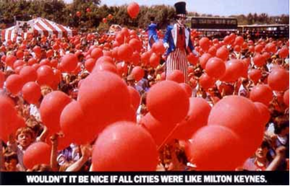
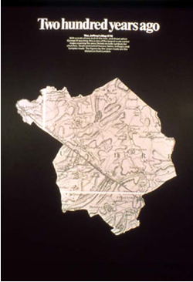
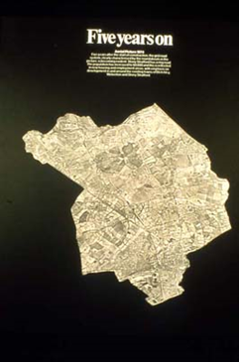
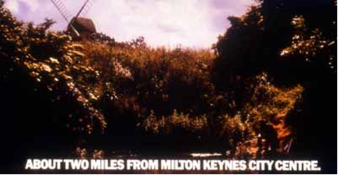
MEMORIES AND THE PEOPLE OF MILTON KEYNES:
In this final section topics include:
MKDC advertising
A selection of print adverts available for use
Links to film adverts

Slide 16
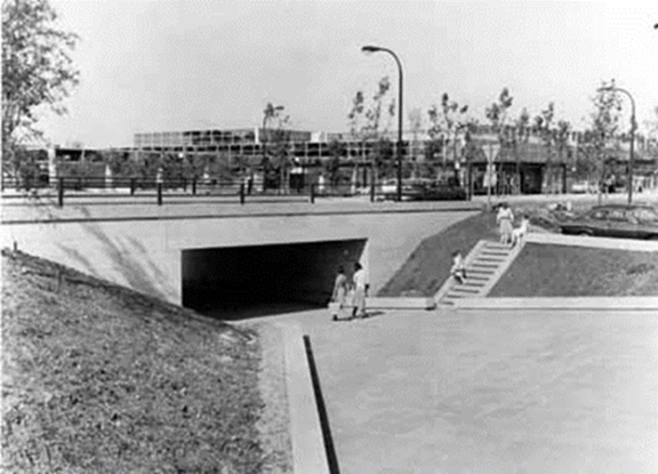
The final document has been provided in PDF form together with an excel spread sheet of the available photographs.
I am waiting to receive a spread sheet from Sue Chaundy regarding the number of underpasses in MK. I will send this through asap.

